Slide 1

Module – 2 : Applications of Diodes
Part – I : Analog Electronics
Chapter 1: Diodes and Applications
Reference: Robert L. Boylestad, Louis Nashelsky, Electronic Devices & Circuit Theory, 11th Edition, PHI, 2012
Department of Electronics and Communication Engineering, MIT, Manipal

Slide 2
Application of Diodes
At the end of this module, students will be able to:
Explain need for AC to DC conversion
Discuss basic DC power supply unit.
Discuss and analyze the working of a various rectifier circuits.
Explain how capacitor filter can be used to minimize the ac component.

Slide 3
CONTENT
Introduction
Half wave rectifier (HWR)
Full wave rectifiers:
Center tapped FWR
Bridge Rectifier
Capacitor filter

Slide 4
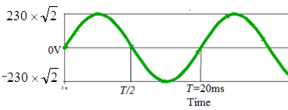
INTRODUCTION
What is an AC and an DC signal?
Eg. of AC signal
Define
Average value
RMS or effective value
Electricity Distribution in INDIA: AC signal of 230V, 50HZ.
Necessity of DC power: Many electronic gadgets
Fig. 1: AC signal with A=230V, f=50Hz
Note: The average or DC value of this signal is equal to zero.
Notes:
AC signal: Is a signal whose values keep changing, such that the average value is zero.
Figure: A=230x(root(2)) V, f=1/20msec=50Hz
DC signal: A signal that is constant valued.
Pure sinusoidal input signal Vin(t); A is the Amplitude in volts, w=2𝜋𝑓 called angular frequency in rad/sec, f is frequency in Hz.
Average or DC value: The dc value of a signal is the average value of that signal. The root mean square(RMS) value of the signal is the effective value which produces the same heating effect as the alternating component. Mathematical equations refer notes equation (1.2.1) & (1.2.2)
The average value of this signal is zero.

Slide 5
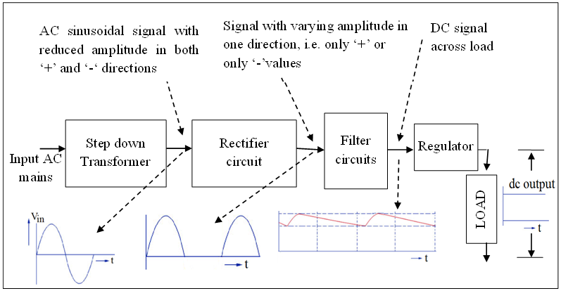
INTRODUCTION
DC power supply
Fig. 2 : Block Diagram of Basic DC power supply
Notes:
A step down transformer reduces the voltage of an ac signal is called a step down transformer.
Rectifiers converts an ac sinusoidal signal that is bidirectional with positive and negative amplitudes into a signal with only unidirectional amplitudes that is only positive or only negative. Thus rectifier circuit forces the current through the load to flow in only in one direction. The out put of rectifier is called pulsating dc signal.
Converts AC signal to pulsating DC
Primary element: Diode
Two types of rectifiers are: Half wave rectifier
Full wave rectifier
Full wave rectifier
Center-tapped transformer FWR
Bridge FWR
A filter circuit filters ac content from pulsating dc. A filter has to have a capacitor, an energy storing component that can hold the voltage to the peak value of the rectified pulsating dc and then dissipate energy to load when the pulsating dc drops.
Finally regulator is used to provide constant dc voltage despite of variations in the mains ac power supply or load variations.

Slide 6
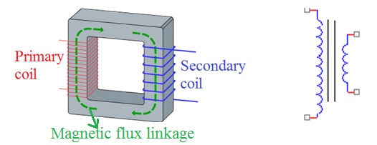
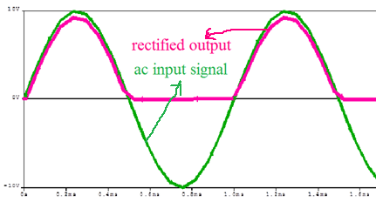
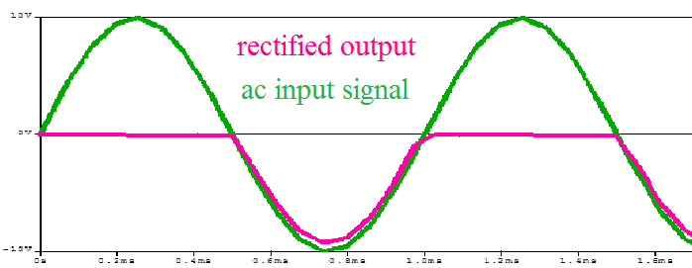
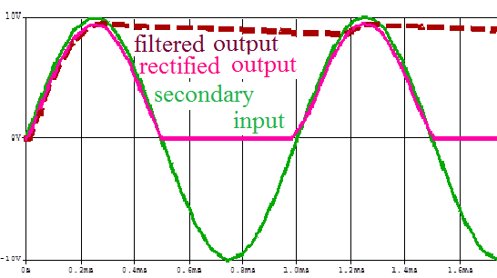
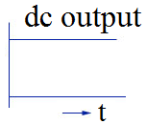
INTRODUCTION
Blocks of DC power supply
Fig3: Step down transformer
Fig 4: Rectified output w.r.t. transformer output
Fig 5: Filtered output
Fig 6: Regulator output
Notes:
A step down transformer reduces the voltage of an ac signal is called a step down transformer.
Rectifiers converts an ac sinusoidal signal that is bidirectional with positive and negative amplitudes into a signal with only unidirectional amplitudes that is only positive or only negative. Thus rectifier circuit forces the current through the load to flow in only in one direction. The out put of rectifier is called pulsating dc signal.
A filter circuit filters ac content from pulsating dc. A filter has to have a capacitor, an energy storing component that can hold the voltage to the peak value of the rectified pulsating dc and then dissipate energy to load when the pulsating dc drops.
Finally regulator is used to provide constant dc voltage despite of variations in the mains ac power supply or load variations.

Slide 7
Activity
INTRODUCTION
1. List in a table the names of at least six products/applications that we use in daily life that require dc power supply along with the range of values.
2. List the appliances or products around us that need power supply. Classify them under the umbrella of dc or ac power supply that is used for its working.
Notes:
One cannot imagine life without electronic products like iron box, mixers, grinders, refrigerators, washing machines, microwave oven, televisions, mobiles, computers, laptops to name a few that we use in our daily lives. Some of them need AC power supply and some need DC power supply. First two test question is an activity just to know electronic equipment's that we use everyday better.
Next two test question is a summary of what we discussed so far and that we will be studying in detail in the following sections.

Slide 8
CONTENT
Introduction: Basic DC power supply
Half wave rectifier (HWR)
Full wave rectifiers:
Center tapped FWR
Bridge Rectifier
Capacitor filter

Slide 9
RECTIFIER
Converts AC signal to pulsating DC
Primary element: Diode
Two types of rectifiers are: Half wave rectifier
Full wave rectifier
Full wave rectifier
Center-tapped transformer FWR
Bridge FWR
Notes:
HWR: Only half of the input cycle (positive or negative) is rectified
FWR: Both positive and negative half cycles are rectified

Slide 10
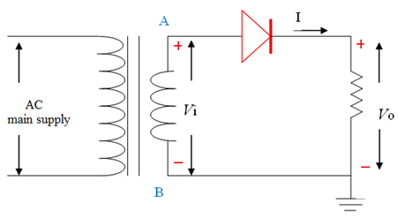
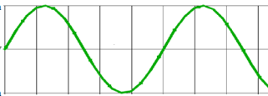

HALF WAVE RECTIFIER (HWR)
Fig 7: Circuit of HWR
Diode passes only for half of the signal time period Hence the name HWR.
Notes:
The half wave rectifier consists of a single semiconductor diode, the key component of rectifiers.
Diode passes only for half of the signal time period and hence the name HWR.
The secondary voltage of transformer (node between A & B) is fed as an input of a rectifier circuit. The output is measured across the load resistor R_{L}

Slide 11
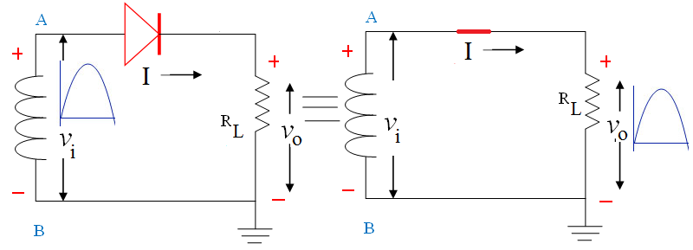
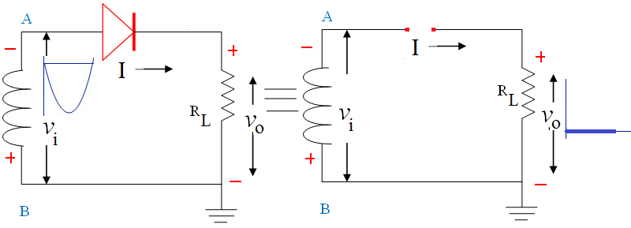
Working HWR
Fig 8: Equivalent Circuit of HWR, when node A is positive w.r.t node B
Fig 9: Equivalent Circuit of HWR, when node A is negative w.r.t node B
Note: Current through load exist only for one half cycle
Notes:
Fig 8: Voltage at node A is positive with respect to voltage at node B, forces the diode to be forward bias and act as a short. This results in current flow through the load resistance R_{L}. Hence output voltage is approximately equal to the secondary voltage.
fig. 9: during the negative half cycle, the voltage at node A is negative with respect to node B that forces the diode in reverse biased and act as open circuit. This results in no current flow through the load

Slide 12
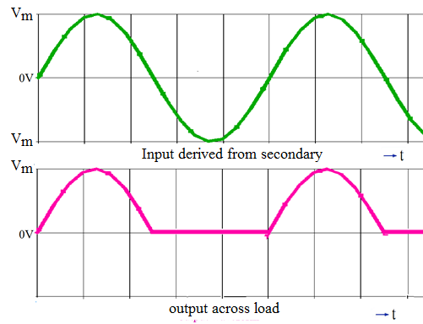
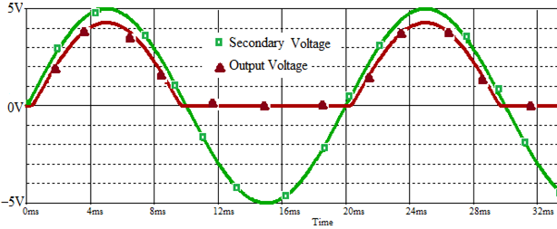
HALF WAVE RECTIFIER
Fig 10: Input and rectified output with ideal diode
Simulation of HWR
Fig 11: Secondary input and rectified output with practical diode
Notes:
Fig 10: diodes considered are ideal
Fig 11: Simulated result considering practical diode

Slide 13
RECTIFIER
Performance of Rectifiers is measured using the following parameters:
DC voltage
Peak Inverse Voltage (PIV)
Ripple factor
Efficiency
Notes:
PIV: It is defined as the maximum voltage across the reverse biased diode before the diode breaks down. It is essential that the diode used in rectifier circuit should be able to withstand the voltage available across it when it is reversed biased so that it acts as open circuit and does not enter into a breakdown state.
Ripple factor γ is defined as the ratio of rms value of ac component to dc component.
Ripple factor actually measures the amount of ac content still remaining as compared to the dc (or average) content in the pulsating dc.
Efficiency (η) is the ratio of the dc output power to ac input power
Efficiency signifies the outcome of the rectifier circuit to output dc power in comparison to ac input power.

Slide 14
HALF WAVE RECTIFIER
Assume ideal diodes
During positive cycle i = I_{m} sin(ωt)
Peak current
During negative half cycle, i = 0
Average value of load current in half wave rectifier is non zero

Slide 15
Half Wave Rectifier
Average output voltage is
RMS value of load current in half wave rectifier is:
RMS output voltage is

Slide 16
Half Wave Rectifier
PIV : should be greater than V_{m} , peak of secondary voltage.
Ripple factor is:
Efficiency:

Slide 17
HWR
Self Test
HWR is used to rectify the AC signal which has peak value of 25V. Which all diodes can be selected whose PIV rating is
(a) 5V (b) 15V (c) 30V (d) both a and b
ACTIVITY: Do it yourself
2. what happens when the diode connection is reversed? Draw the input and output waveform. Will the values of PIV, ripple factor and efficiency for this changed circuit change?

Slide 18
Half Wave Rectifier
Advantages of HWR
Simple circuit
Single diode
PIV rating is V_{m}
Disadvantages of HWR
High ripple factor
Low efficiency

Slide 19
CONTENT
Introduction: Basic DC power supply
Half wave rectifier (HWR)
Center tapped Full Wave rectifier (FWR)
Capacitor filter

Slide 20
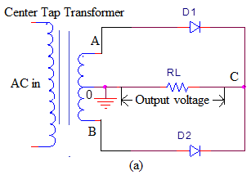
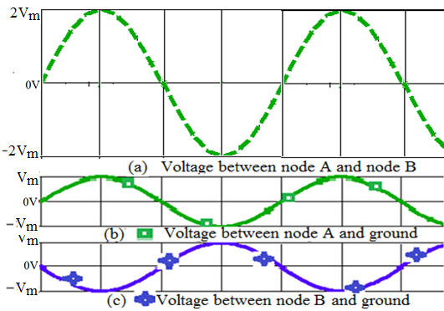
Center Tapped FWR
Fig.12 center tapped FWR
Fig. 13: Secondary waveforms
Notes:
The output of a center tapped transformer is available in three different forms. The secondary voltage observed between the extreme end nodes i.e between node A and node B is a stepped down voltage as shown in fig. 13(a). The voltages measured at between node A and center node (ground) or node B and center node is half in magnitude in comparison to the voltage measured between node A and node B. Also very interesting point is that voltage at node A is 180° out of phase with the voltage at node B when measured relative to the center node (ground). All these secondary waveforms are shown in fig. 13b,c

Slide 21
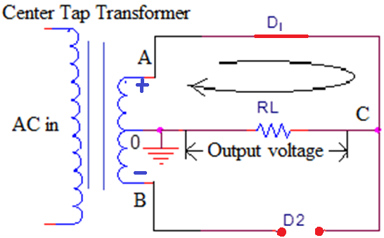
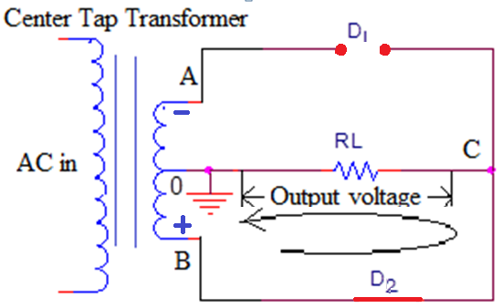
Working of center tapped FWR
Fig. 14: Center tapped FWR for node A is positive w.r.t B
Fig. 15: Center tapped FWR for node B is positive w.r.t. A
Note: Current through load during both cycles is in same direction (from node C to ground)
Notes:
During the first half cycle, the voltage at node A is positive and voltage at node B is negative measured with respect to ground. Diode D1 gets forward biased and acts as a short whereas diode D2 is reverse biased and acts as open. This results in a current flow through upper half secondary windings of transformer, diode D1 and the load RL. Direction of the current through the load is towards the ground from node C. Hence the output voltage measured at node C with respect to ground is equal to voltage at node A measured with respect to ground.
Similar explaination holds good for second half of time period

Slide 22
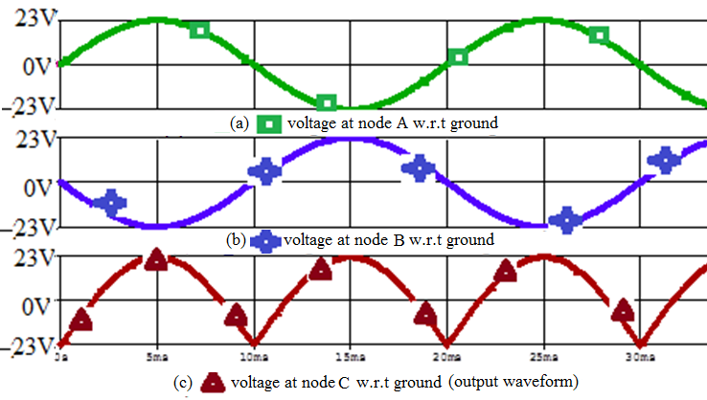
Center Tapped FWR
Fig. 16 : Input secondary and output waveforms
Note: The frequency of the output signal =2 times the input frequency
Notes:
The output waveform observed across load resistor along with voltage waveforms at node A and node B with respect to ground
Thus rectified output is unidirectional that exist for the entire time period.
Also

Slide 23
Center tapped FWR
The Average of output voltage
The Average of output current
RMS value of the voltage at the load is

Slide 24
Center tapped FWR
PIV : 2V_{m} , where V_{m} peak of secondary voltage (between node A and ground or between node B and ground)
Ripple factor is:
Efficiency:

Slide 25
Center Tapped FWR
Self Test
Choose the correct answer: (T is the time period of the input signal)
1. In HWR, the diode is forward biased for what duration of the time period?
(a) T/2 b) T/4 c) 3T/4 d) T
2. In center tapped FWR, each diode is forward biased for what duration of the time period?
(a) T/2 b) T/4 c) 3T/4 d) T
3. In a center tapped FWR , current through load resistor flows for what duration of the time period?
T/2 b) T/4 c) 3T/4 d) T
The ripple factor of FWR is greater than HWR
(a) True (b) False
Notes:
Ans: 1. T/2 2. T/2 3. T

Slide 26
Comparison of HWR and FWR
Advantages of center tapped FWR over HWR
High Efficiency
low ripple factor
Disadvantages of center tapped FWR over HWR
Uses 2 diodes
Uses center tapped transformer

Slide 27
Solved Exercise
A center-tapped FWR is supplied with 230V, 50 Hz AC mains through a step down transformer with turns ratio equal to 10. Find the average and RMS value of the load current, rating of the diode used for proper working. PIV .
Given: Input AC mains RMS voltage =230V, turns ratio=10,
Hence Secondary RMS voltage =230/10=23V
Solution: ….

Slide 28
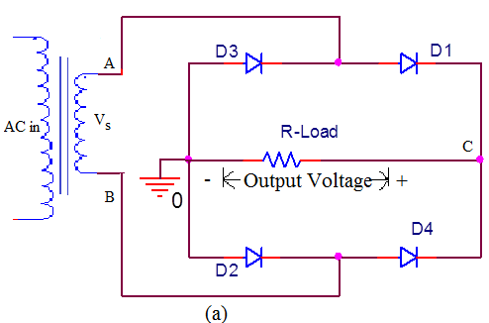
Bridge rectifier
Fig.17(a) : Bridge FWR
Notes:
The bridge rectifier consists of four diodes in the form of a bridge. We can represent two parallel paths, each path with two diodes and all diodes directed in the same direction. The top path consists of diode D3 and D1 whereas bottom path consists of diode D2 and D4 respectively. Load resistor is connected between the ends of two parallel paths (i.e node C and ground). The secondary input is between the two centers of two the two parallel paths (one between D1,D3 and other between D4, D2)
Output is measured across load resistor.

Slide 29
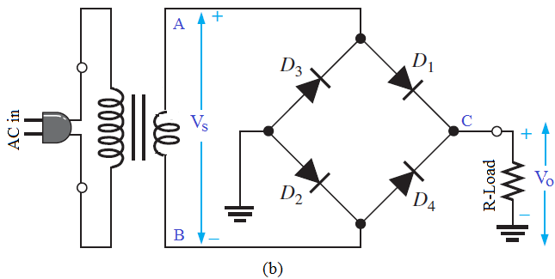
Bridge rectifier
Fig.17 (b): Bridge FWR
Notes:
The bridge rectifier consists of four diodes in the form of a bridge. We can represent two parallel paths, each path with two diodes and all diodes directed in the same direction. The top path consists of diode D3 and D1 whereas bottom path consists of diode D2 and D4 respectively. Load resistor is connected between the ends of two parallel paths (i.e node C and ground). The secondary input is between the two centers of two the two parallel paths (one between D1,D3 and other between D4, D2)
Output is measured across load resistor.

Slide 30
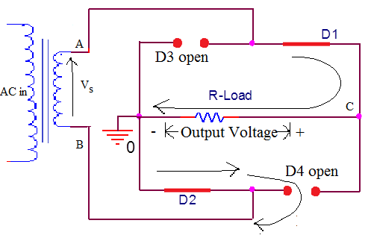
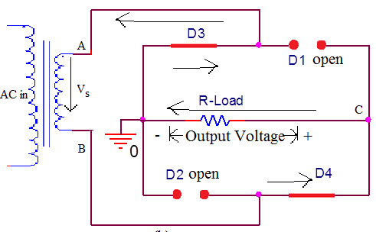
Working of Bridge FWR
Fig. 18: Bridge FWR when node A is positive w.r.t B
Fig. 19: Bridge FWR when node B is positive w.r.t. A
Note: Current through load for both cycles is in same direction
(from node C to ground)
Notes:
For the first half of the time period, during which node A is positive with respect to B, D1 and D2 are forward biased whereas D3 and D4 are reverse biased. As said earlier considering ideal diodes D1, D2 are shorted and D3,D4 are open as in fig 18. This results in a current flow taking a closed path from node A, through D1, R-Load, D2 and from node B through the secondary coil as indicated. Note that current through the load resistor flows from node C to ground.
Similarly for the second half of the time period, during which node B is positive with respect to A, D3 and D4 are forward biased whereas D1 and D2 are reverse biased. Diodes D3, D4 are shorted and D1,D2 are open as shown in figure 19. This results in a current flow taking a closed path from node B, through D4, R-Load, D3 and from node A through the secondary coil as indicated. Note that again current through the load resistor flows from node C to ground even though the current through the secondary has reversed.
Thus output voltage is unidirectional for both the half cycle

Slide 31
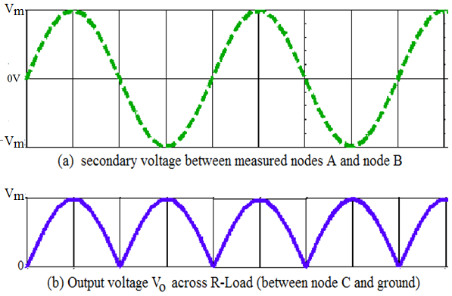
Bridge FWR
Simulation of FWR
Fig. 20 : Input and output waveforms of bridge rectifier
Note: The frequency of the output signal =2 times the input frequency

Slide 32
Bridge FWR
PIV : V_{m} , where V_{m} peak of secondary voltage (between node A and node B).
Other parameters same as Center tapped FWR:
Ripple factor is:
Efficiency:

Slide 33
Comparison of Rectifiers
Advantages of HWR over FWR
Advantages of Center tapped FWR rectifier over HWR
Advantages of bridge rectifier over to centre-tap FWR
Disadvantages of HWR over FWR
Disadvantages of centre-tap FWR over Bridge
Disadvantages of bridge rectifier over other rectifiers
Notes:
Advantages of HWR over FWR
Simple circuit
Single diode
PIV rating is V_{m}
Advantages of Center tapped FWR rectifier over HWR
High Efficiency
low ripple factor
Advantages of bridge rectifier over to centre-tap FWR
PIV rating is Vm
Does not use Centre-tap transformer
Disadvantages of HWR over FWR
High ripple factor
Low efficiency
Disadvantages of centre-tap FWR over Bridge
Uses center tapped transformer
Disadvantages of bridge rectifier over other rectifiers
Four diodes are used

Slide 34
Comparison of Rectifiers
Parameters of rectified signal | HWR | Center-tapped FWR | Bridge FWR
V_{dc}
V_{RMS}
PIV
Ripple factor
Efficiency
Frequency f_{o}
1.21 0.483 0.483
40.6% 81.2% 81.2%

Slide 35
Capacitor Filter
Commonly referred as C type filter
Key component of filter is the energy storing elements. Example: Capacitor
Capacitor helps to hold the output voltage to its maximum or peak value.
It can be used with HWR as well as with FWR

Slide 36
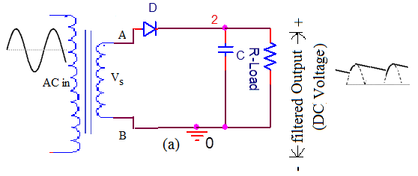
Capacitor Filter
Fig 21: C type filter with HWR
Notes:
The property of a capacitor is that, it allows ac component and blocks dc component. The operation of the capacitor filter is to minimize the ripple and to increase the dc voltage.

Slide 37
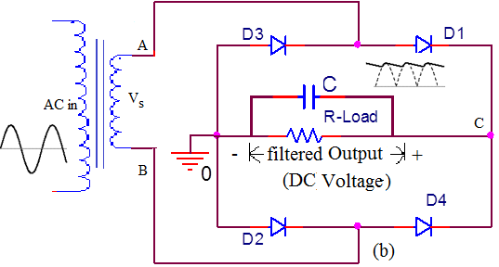
Capacitor Filter
Fig 22: C type filter with Bridge FWR
Simulation of HWR/FWR with C filter: with varying R and C

Slide 38
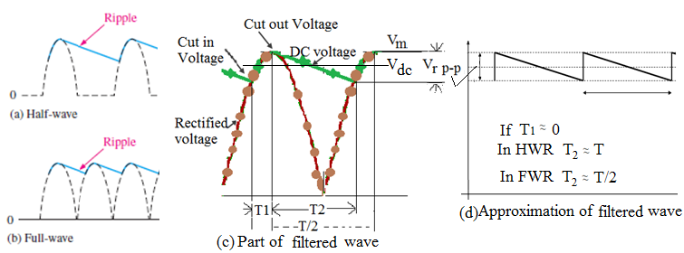
Capacitor Filter
Fig. 23 Filtered output waveform using C type filter
Notes:
The capacitor charges to its peak value through Diode and secondary. But as the voltage starts reducing from peak value the Capacitor tries to retain the voltage to the peak. But the capacitor will discharge through the load resistance slowly until the transformer secondary voltage again increases to a value greater than the capacitor voltage.

Slide 39
Ripple factor with Capacitor Filter
For HWR
For FWR

Slide 40
Ripple factor with Capacitor Filter
DC value of filtered output for HWR
DC value of filtered output for FWR
Note: here f is the frequency of the input signal

Slide 41
Comparison of Rectifiers
Parameters of rectified signal | HWR | FWR
V_{dc}
Ripple factor

Slide 42
Summary
At the end of this module, students will be able to:
Discuss block diagram of a basic DC power supply unit.
Explain and analyze the working of various rectifier circuits.
Evaluate Output DC value, ripple factor, efficiency and PIV, of different rectifier circuits.
Explain the working of rectifier circuits with capacitor filter

Slide 43
Exercise Problems
. Primary voltage is 120V, 60Hz. Turns ratio is 5:1. This transformer supplies to bridge rectifier employing 4 identical ideal diodes. The load resistance is 1kΩ. Calculate average and rms load voltage, efficiency, ripple factor, PIV rating and frequency of output waveform.
. Repeat this problem for center tapped FWR. Comment on the results comparing with results of exercise 1.

Slide 44
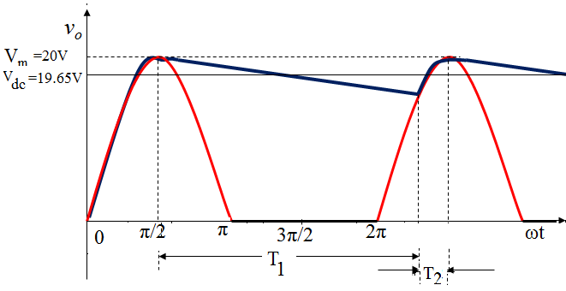
Exercise Problems
3. A half wave rectifier with capacitor filter is supplied from transformer having peak secondary voltage 20V and freq 50Hz. The load resistance is 560Ω and capacitor used is 1000μF. Calculate ripple factor and dc output voltage. Draw the filtered output and label peak and dc value.
(Ans. for part a: 0.0103, 19.65V)

